Slide 1
LPG Gas Leakage Detection
YESANULLA.D
VAISHNAVI.G
SNEHA.M
DHANYA SREE.N

Slide 2
ABSTRACT:
Our project aims to present such a design that can automatically detect, alarm, and control gas leakage using an exhaust fan to suck the gas away from the premises where there is gas leakage. Arduino UNO is used as the main controller of the system and the buzzer is used as a medium of notification. The system will detect the leakage of the Liquefied Petroleum Gas (LPG) using a gas sensor and uses the buzzer to alarm about the gas leakage The device is intended for use in household safety where appliances and heaters that use natural gas and LPG may be a source of risk. The system can also be used for other application in the industries or companies that depends on LPG and natural gas in their operation.

Slide 3
PAPER1
LPG LEAKAGE DETECTION SYSTEM USING GPS AND GSM TECHNOLOGY
http://gradivareview.com/gallery/grj%203732.pdf
Proposed Methodology:
1. Controller is used to control all the process of system. LPG sensor used to sense the leakage of LPG gas and give indication to controller.
2. LCD is used to display the percentage of LPG gas.
3. GSM is used to send the Leakage message and alert SMS to user.
4. Buzzer is used to give audio signal to user in case of leakage.
5. GPS is used to give exact location of leakage.

Slide 4
PAPER-2
Gas Leakage Detection Based on IOT
Mq 5 sensor, Arduino,Relay,LCD display,Load cell ,Wifi modem,Buzzer
Mq 5 sensor capable of measuring electrode and heater covered by plastic and stainless steel
Arduino Arduino is a microcontroller, whose main aim is to make electronic to be as easy as possible. It uses different microcontrollers, containing several input and output pins
Relay A relay is an electrical switch which is used to control all other electronic devices
LCD display LCD (liquid crystal display) contains two interfaces on upper and lower side of the module
Load cell Load cell is a transducer which is used to transform force into electronic output
Wifi modem WiFi network can easily establish a connection through a serving WiFi adapter.
Buzzer A buzzer is an audio signaling device which is capable of controlling microcontrollers

Slide 5
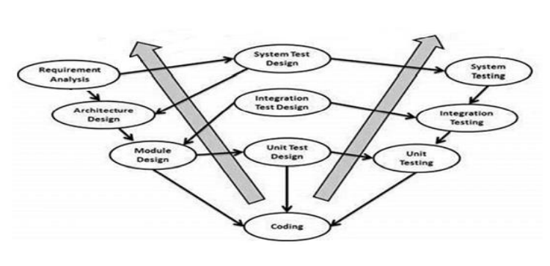
LPG Leakage Detector using Arduino with SMS Alert and Sound Alarm
Methodology
V Model:
The V-model technique was used to acquire the project. This technique is
very easy to apprehend and utilize. The simplicity of this technique also
makes it simpler to accomplish. The V-Model is based on the relationship of a
testing stage for each corresponding improvement level.
This means that for every single segment in the improvement drive,
there is a directly correlated testing phase. This is a highly-restricted
model and the next stage starts only after the end of the previous phase.

Slide 6
LPG Gas Leakage Monitoring and Alert System using Arduino
Methodology
The systematic, theoretical analysis of the methods applied to a field of study. It comprises the theoretical analysis of the body of methods and principles associated with a branch of knowledge. Typically, it encompasses concepts such as paradigm, theoretical model, phases and quantitative or qualitative techniques. A methodology does not set out to provide solutions—it is therefore, not the same as a method. Instead, a methodology offers the theoretical underpinning for understanding which method, set of methods, or best practices can be applied to a specific case. Through a methodology, we are achieving the knowledge about planning, design, and implementation and testing.

Slide 7
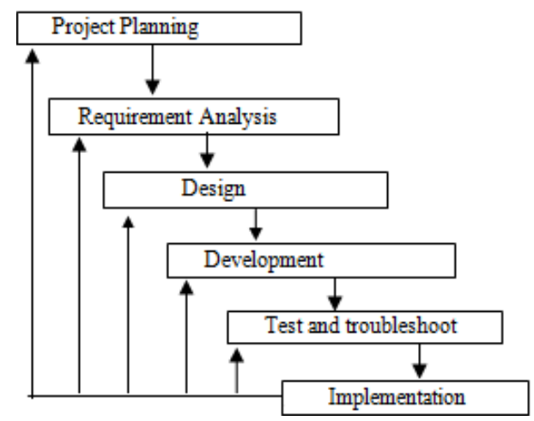
LPG Gas Leakage Monitoring and Alert System using Arduino
The workflow of the project is divided into 6 steps:

Slide 8
Gas leakage detection and alerting system using Arduino Uno:
https://www.researchgate.net/publication/347495607_Gas_leakage_detection_and_alerting_system_using_Arduino_Uno
Arduino UNO (Atmega-328) is the main unit of the system.
A signal conditioning of the Arduino UNO is done by output signal of the sensor(MQ-2, MQ-7, MQ-135) and power supply, provided input to Arduino.
The detection results displayed in LCD. And, the buzzer activity with beep(siren) sound is made.
Also send alert SMS to the in charge of the plant whose number is saved in SIM card by using GSM modem. The SMS received depends upon the leak of gas in the detection area of the sensor.
If the LPG sensor senses gas leak from workplace or home, sensor output goes to active low (logic-0) condition. Arduino UNO is used in the project; low signals are overlooked by the Arduino and gas leakage is been noticed by the Arduino. The Arduino UNO turns on the LCD and buzzer. It even turns on the GSM modem after that, it continues to send messages SMS to mobile number specifically mentioned in the program of the source code for alerting danger to the people.

Slide 9
Sensor-Based Gas Leakage Detector System: https://www.researchgate.net/publication/347326171_Sensor-Based_Gas_Leakage_Detector_System
Semiconductor sensors(MQ6) are used to detect LPG gas.
The sensor could be used to detect different combustible gasses.The sensor’s output is an analog resistance.
This system is based on the Arduino UNO R3 and MQ-6 gas sensor.
When the sensor detects gas in the atmosphere, it will give digital output 1 and if gas in not detected the sensor will give digital output 0.
Arduino will receive the sensor output as digital input.
If the sensor output is high, then the buzzer will start tuning along with the LCD that will show that “Gas detected: Yes”. If the sensor output is low then buzzer will not be tuning, and the LCD will show that “Gas detected: No”.

Slide 10
OBJECTIVE
The purpose of this system is to detect gas leakage, neutralize it, and prevent the explosion.
To design and develop a LPG Gas leakage monitoring & alert system using Arduino.
When the leakage detected send an alarm notification on SMS
Other will be automatically switching on the exhaust fan available in kitchen as soon the gas leakage is been detected.

Slide 11
COMPONENTS:
-Arduino uno
-Gas Sensor mq5
-power supply
-relay module (single channel)5V
-DC brushless fan(5V)
-DC 5V LED
-5V pizzo buzzer
-9V battery x 3 and 2X switch
-DC motor

Slide 12
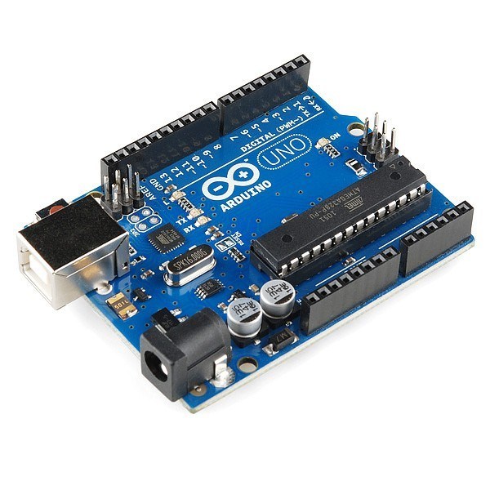

ARDUINO UNO 9v battery

Slide 13
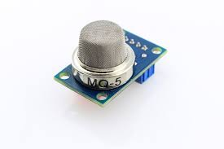
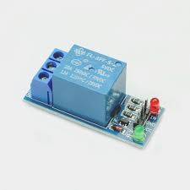
GAS SENSOR RELAY

Slide 14
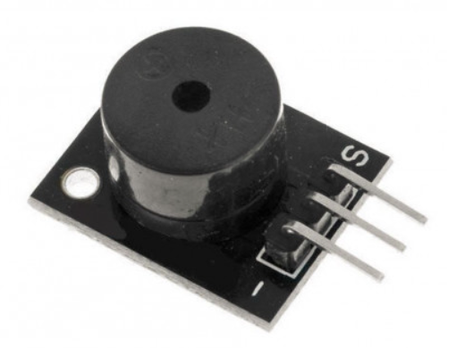
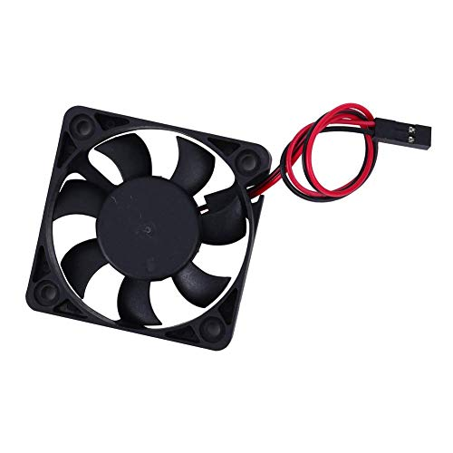
EXHAUST FAN BUZZER

Slide 15


DC MOTOR led

Slide 16
Explanation:
Arduino board is main component which manipulated and maintain the hardware components which are connected towards it , there is gas sensor here mq5 gas sensor is been used , which poses certain threshold value such .5 ppm . The relay is power supply which is been connected to the arduino the connection from relay is given to buzzer ,exhaust fan and other home applicants such as light and fan .Gas sensor helps to detect the leakage gives signal to arduino ,then input given to relay it power off the home Appliance simultaneously the exhaust fan and buzzer will be battery based so it runs as well the intimation is made. There is separate connection for sms will be operated through arduino for message notifying.

Slide 17
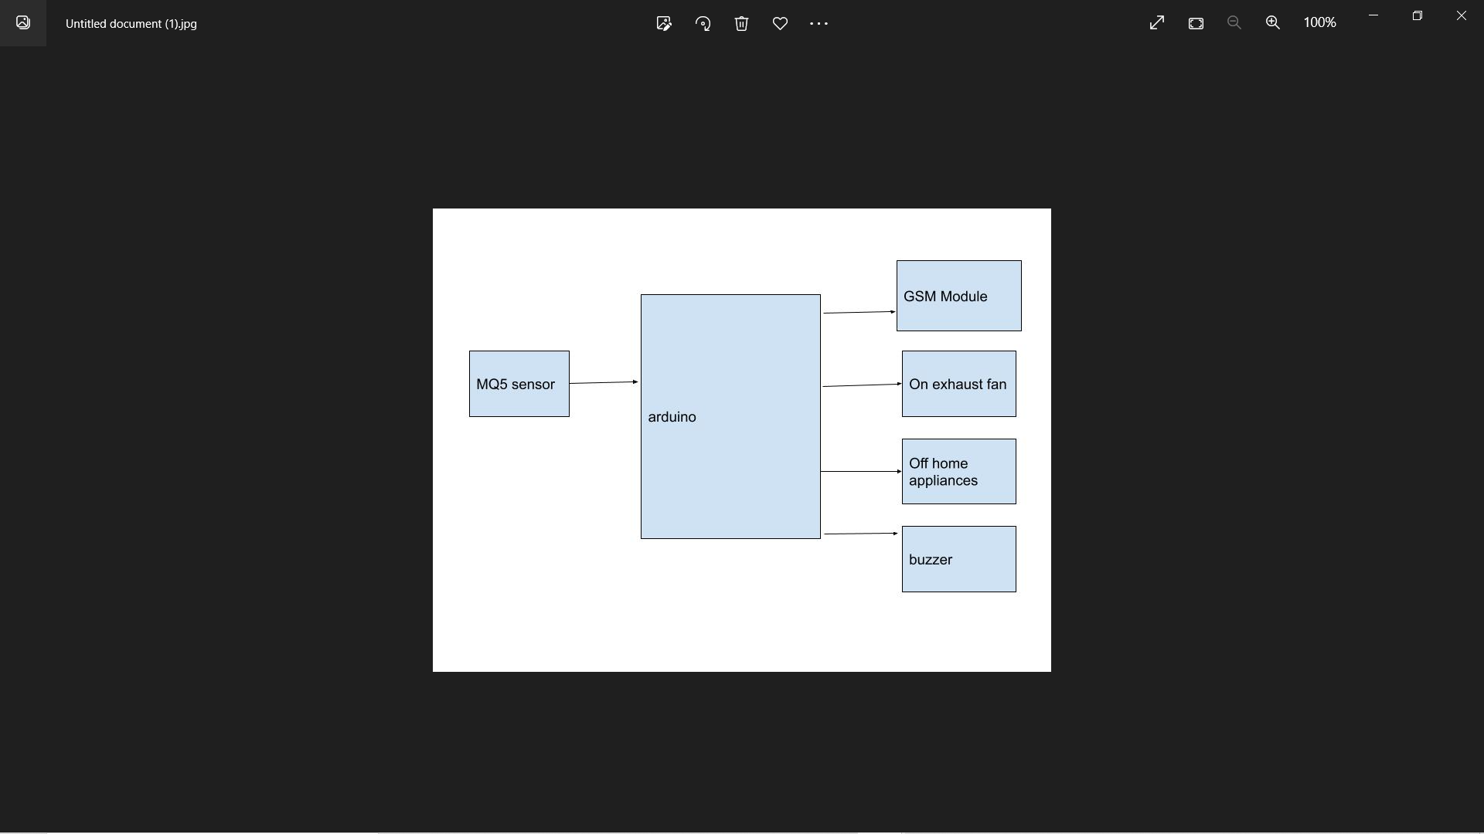
BLOCK DIAGRAM

Slide 18
TEST CASE: (from mq5 sensor to arduino uno then to output devices )
Test case -0
No led,no buzzer ,no power supply to exhaust fan
Test case 1
Led is on ,buzzer sound ,exhaust fan is on,
power off home appliance .
.

Slide 19
